Slide 1


A Case Study on Sustainable Tourism
July 16th 2024
June Huang

Slide 2

About June Huang
Born in Taiwan
Chairman of the Board of Airline Ambassadors International (AAI)
Managing Director of Windsor International Education Group
Executive Director of The Windsor School
Over 20 years of experience in youth education and summer camps
Music teacher at Jing Xin Middle School of Taipei
Chief cellist of the C.W Post Symphony Orchestra at Long Island University
Second cellist of the Taipei Symphony Philharmonic Orchestra
Master's Degree in Music Education from New York University
Bachelor's Degree in Piano and Cello Performance from National Taipei University

Slide 3

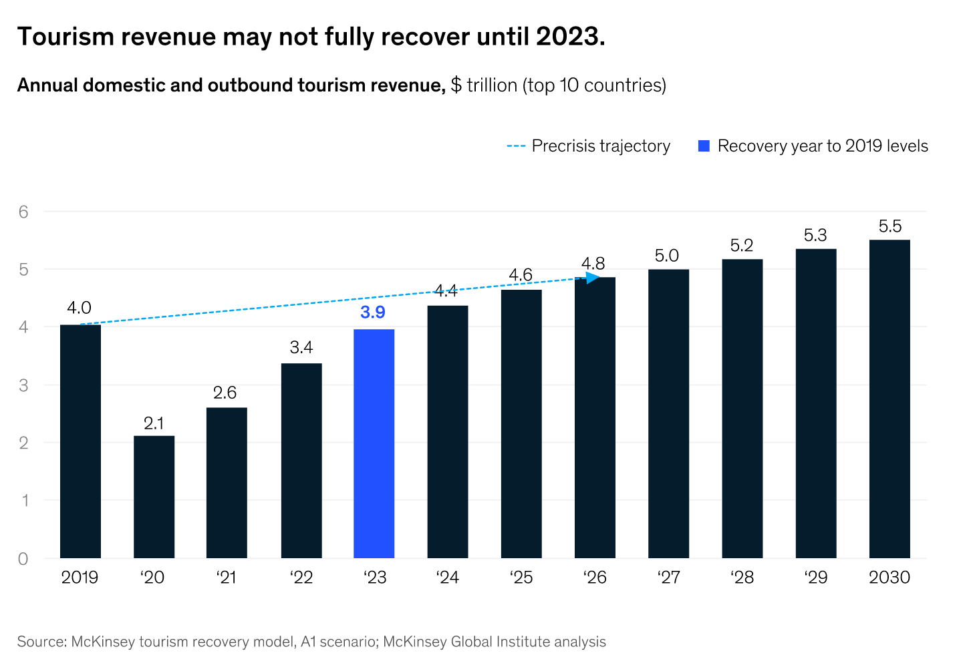
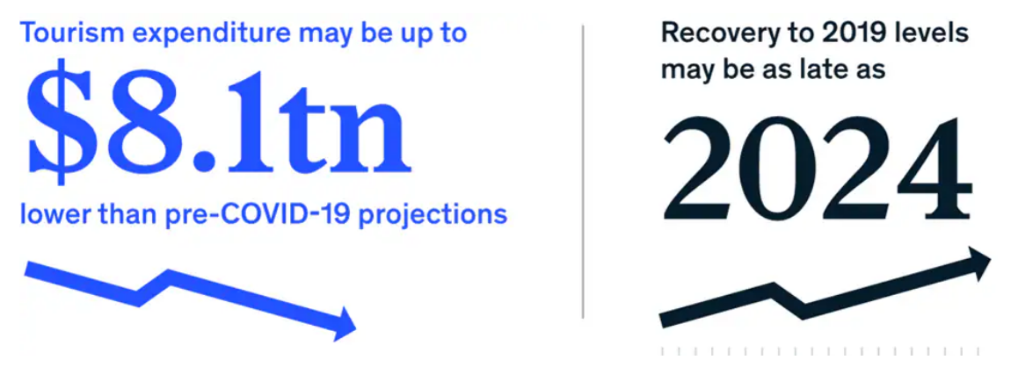
Reflection on Global Tourism
Global tourism was one of the most affected sectors during the COVID-19 crisis. A cumulative drop of $3 trillion to $8 trillion before tourism expenditure returns to pre-COVID-19 levels. Recovery will be slow and driven by the underlying dependencies countries had on domestic and non-air travel.
An estimated 1286 million international tourists (overnight visitors) were recorded around the world in 2023, an increase of 34% over 2022. International tourism recovered 88% of pre-pandemic levels, supported by strong pent-up demand (UNWTO Tourism Barometer January 2024-Excerpt).

Slide 4


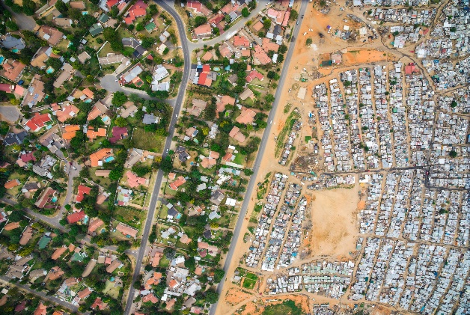

Challenges To The Recovery of Tourism
While the global travel industry as a whole is recovering, rising travel costs and fees, as well as increased travel risks, remain challenges to the recovery of the global travel industry. The following four factors are also hindering the recovery of the global travel industry
Energy Price
High energy prices remain a major impediment to global travel recovery
Geopolitical
War, great power rivalry and games are also important factors contributing to the disruption of global travel
Wealth Disparity
Further widening of the global wealth gap will profoundly affect the structure and frequency of global travel
Protectionism
Globalization and protectionist competition will further hinder the recovery of the global tourism

Slide 5


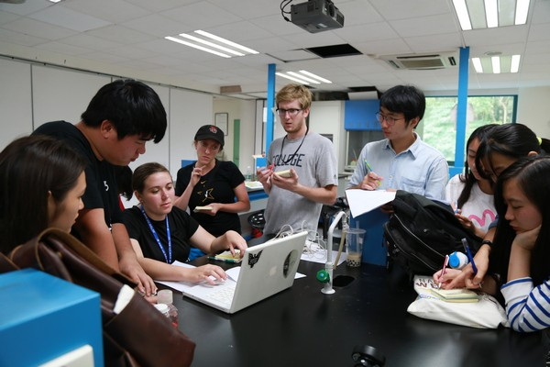
A New Perspective for Sustainable Tourism
We will advocate and support the promotion of youth exchange visits globally by fostering innovation and entrepreneurship among youth globally, and in doing so, promote the development and innovation of the global travel industry.
We enable young students to integrate innovative thinking, entrepreneurship and technological advancement. Allow students with innovative thinking to learn about entrepreneurship around the world and students with entrepreneurial spirit to learn about scientific and technological advances, in order to further promote cultural exchanges and collaboration of ideas among young people around the world
In the summer of 2024, we are organizing a trip to China for young American college students to learn about Chinese entrepreneurship, visit Chinese science and technology companies, and engage in cultural exchanges with Chinese college students.

Slide 6


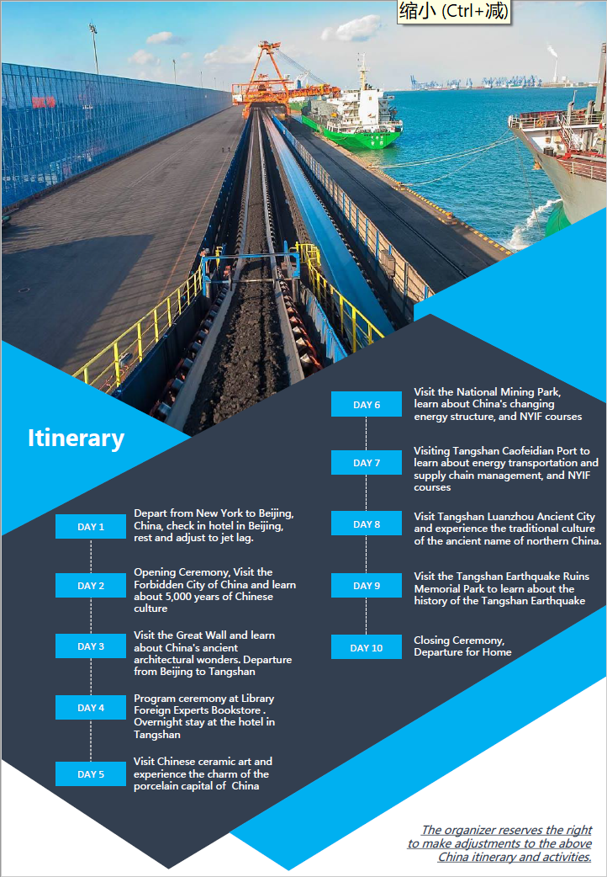

Case Study

Slide 7

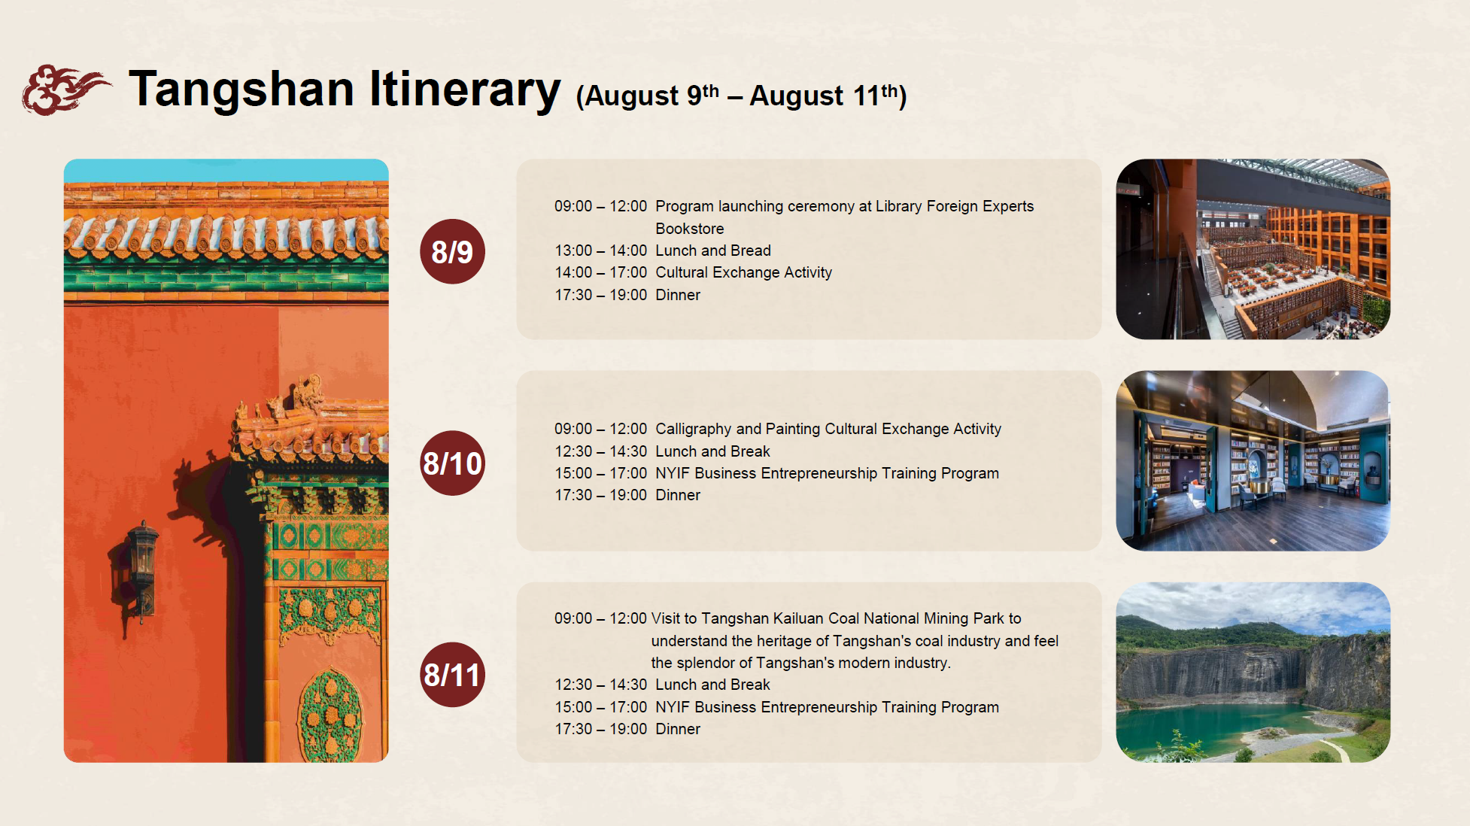

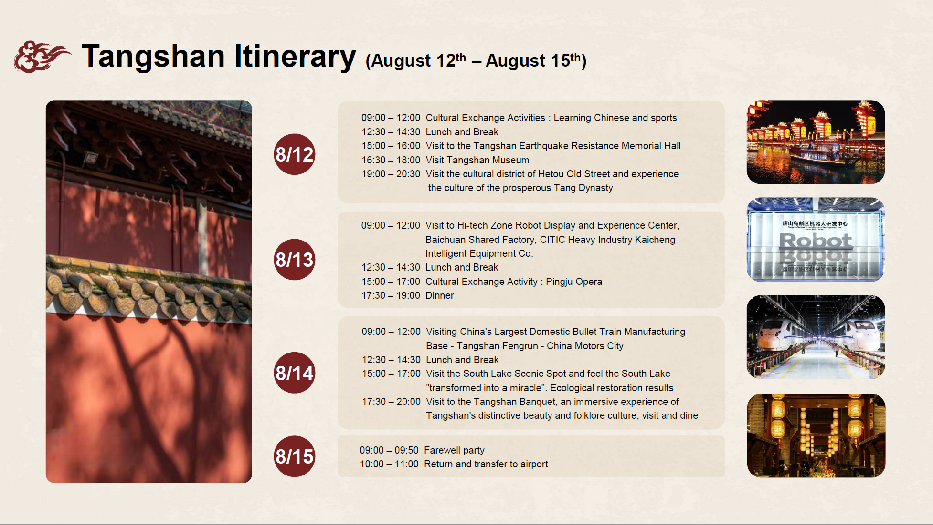
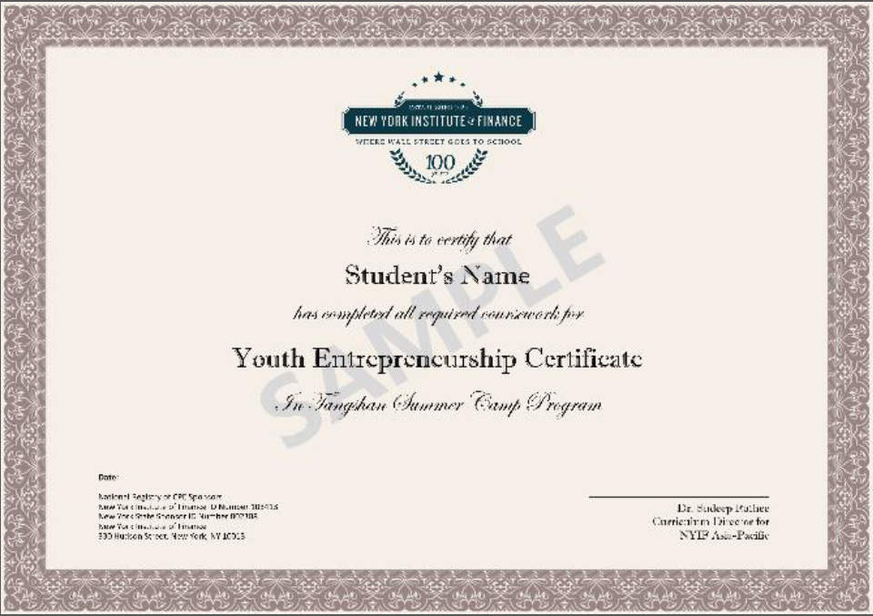
Young Entrepreneurship Program
NYIF Young Entrepreneurship Courses
How to set up a company
What is the Capital Market
Sustainable Development
Fintech

Slide 8
Summary
Cultural Exchange
entrepreneurship courses
Local Sightseeing
text
Market Research
Company Visits
Sustainable Tourism

Slide 9
Thank You

